Slide 1
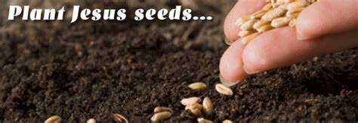
Planting Jesus Seeds
播種耶穌種子 Matthew马太福音 13

Slide 2
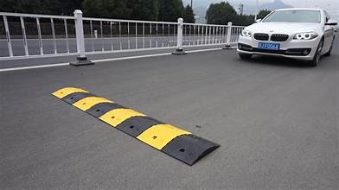
Dad Joke
I HAVE A FEAR OF SPEED BUMPS –
I AM SLOWLY GETTING OVER IT.

Slide 3
Matthew 13:3-8, 18-23
3 Then he told them many things in parables, saying: “A farmer went out to sow his seed. 4 As he was scattering the seed, some fell along the path, and the birds came and ate it up.
马太福音13:3-8，18-23
3 他用比喻对众人讲了许多事，说：“有一个撒种的出去撒种。 4 撒的时候，有的落在路旁，小鸟飞来就吃掉了。

Slide 4
5 Some fell on rocky places, where it did not have much soil. It sprang up quickly, because the soil was shallow. 6 But when the sun came up, the plants were scorched, and they withered because they had no root. 7 Other seed fell among thorns, which grew up and choked the plants. 8 Still other seed fell on good soil, where it produced a crop—a hundred, sixty or thirty times what was sown.
5 有的落在泥土不多的石地上，因为泥土不深，很快就长起来。 6 但太阳一出来，就把它晒干，又因为没有根就枯萎了。 7 有的落在荆棘里，荆棘长大了，就把它挤住。 8 有的落在好土里，结出果实，有一百倍的，有六十倍的，有三十倍的。

Slide 5
解释撒种的比喻
18 “所以你们要听这撒种人的比喻。 19 凡是听了天国的道却不明白的，那恶者就来把撒在他心中的夺去。这就是撒在路旁的。 20 那撒在石地上的，就是人听了道，立刻欢欢喜喜地接受， 21 可是他里面没有根，只是暂时的；一旦为道遭遇患难，受到迫害，就立刻跌倒了。
18 “Listen then to what the parable of the sower means: 19 When anyone hears the message about the kingdom and does not understand it, the evil one comes and snatches away what was sown in their heart. This is the seed sown along the path. 20 The seed falling on rocky ground refers to someone who hears the word and at once receives it with joy. 21 But since they have no root, they last only a short time. When trouble or persecution comes because of the word, they quickly fall away.

Slide 6
22 The seed falling among the thorns refers to someone who hears the word, but the worries of this life and the deceitfulness of wealth choke the word, making it unfruitful. 23 But the seed falling on good soil refers to someone who hears the word and understands it. This is the one who produces a crop, yielding a hundred, sixty or thirty times what was sown.”
22 那撒在荆棘里的，就是人听了道，有今世的忧虑和财富的迷惑把道挤住，结不出果实来。 23 那撒在好土里的，就是人听了道，又明白了，结出果实来，有一百倍的，有六十倍的，有三十倍的。”

Slide 7
What is one of your God-given purposes in life?
PLANTING JESUS SEEDS.
上帝賦予你的人生目標之一是什麼？
播下耶穌的種子。

Slide 8
What is the Jesus seed?
The Word of God. The good news. Jesus Christ
什么是耶稣的种子？
神的话
福音
耶稣基督

Slide 9
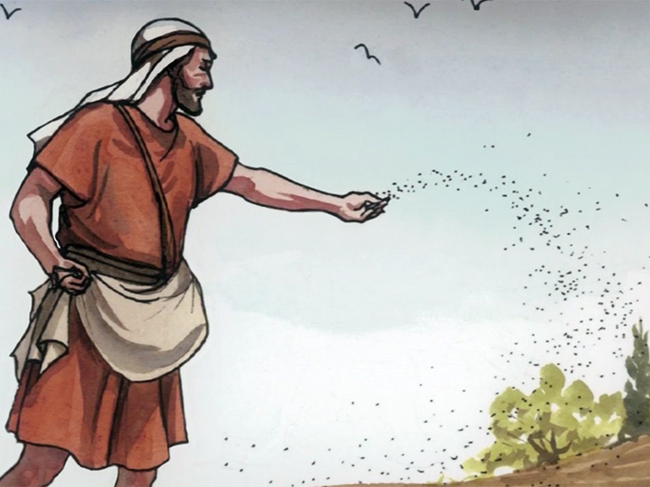
How is the seed planted?
Jesus is Broadcasting
Generously
Intentionally
種子是如何播種的？
耶穌播種:
慷慨地
用心/刻意地

Slide 10
You get to choose How you plant Jesus seeds.
HOW YOU PLANT is just as important as WHAT YOU PLANT.
你可以選擇如何
播種耶穌的種子。
你如何種植
和你種植什麼一樣重要。

Slide 11
Methods of Planting Seeds
Speaking
Action
Character
Prayer –
Encouragement –
播種方式：
口語、
行動、
品格、
禱告、
鼓勵 、

Slide 13
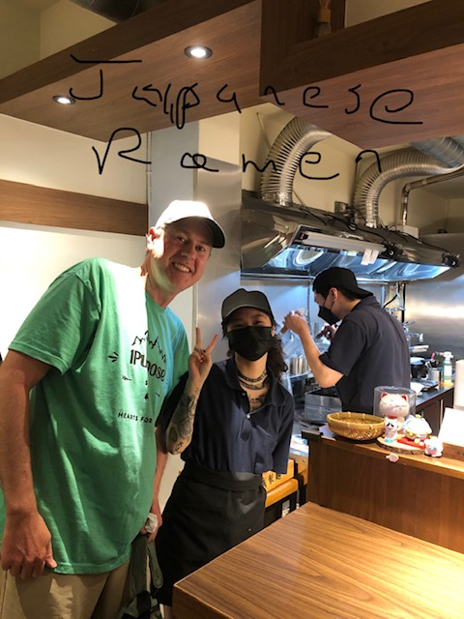

Slide 14
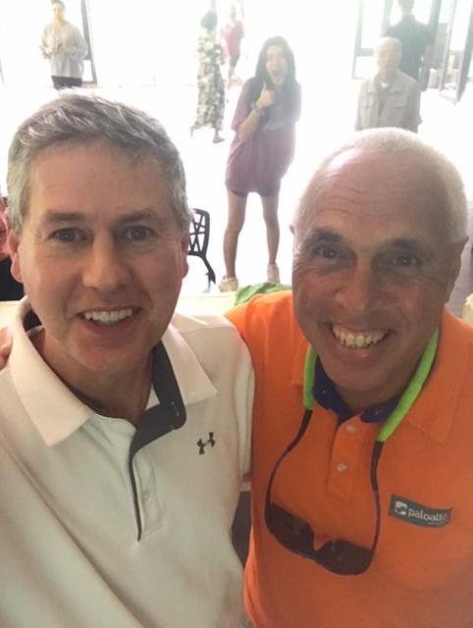
You plant Jesus seeds because someone planted Jesus seeds in you. 你種下耶穌的種子，是因為有人在你心裡種下了耶穌的種子。
Alan Alagata.
1 Timothy 4:12 … set an example for the believers in speech, in conduct, in love, in faith and in purity. ¹² 不 可 叫 人 小 看 你 年 輕 ， 總 要 在 言 語 、 行 為 、 愛 心 、 信 心 、 清 潔 上 ， 都 作 信 徒 的 榜 樣 。

Slide 15
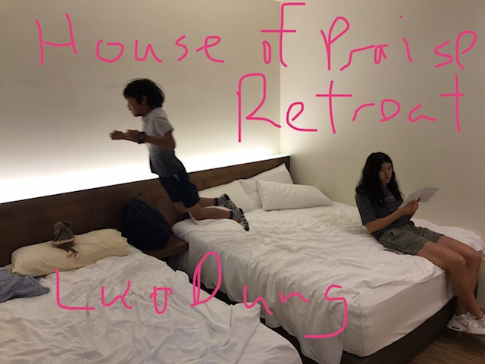
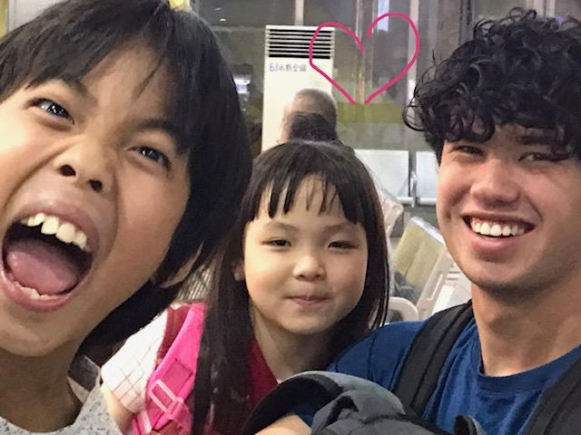
Planting Jesus Seeds & Vacation
Cian and Xina.

Slide 16
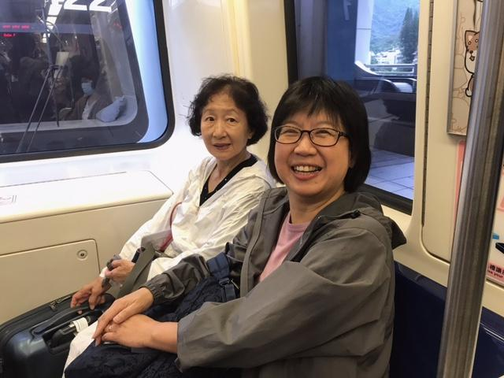
Moving 2 houses

Slide 17
STOP LIVING YOUR JESUS LIFE LIKE YOU ARE ON VACATION.
PLANT JESUS SEEDS ON VACATION, AT HOME, AT WORK, AT ALL TIMES.
不要再像度假一樣過著耶穌的生活。
在度假、在家、在工作中，
任何時候都種下耶穌的種子。

Slide 18
Watch over the Jesus seed planted in You.
1.) Hard Heart
2.) Comfortable Heart
3.) Love the World & Wealth Heart
4.) Soft Receiving Heart
看顧耶穌種在你裡面的種子。
1.） 刚硬的心
2.）舒適的心
3.）愛世界與財富之心
4.）柔軟的接收心

Slide 19
KEEP PLANTING JESUS SEEDS… IT MAKES A DIFFERENCE.
繼續种下耶穌的种子...信靠神會在人的生命中成就我們意想不到的改變。

